Slide 1
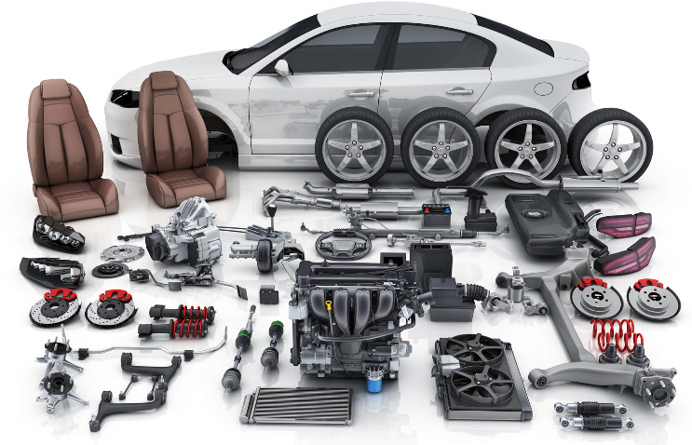
Planning outline
TOPIC Spare Parts

Slide 2
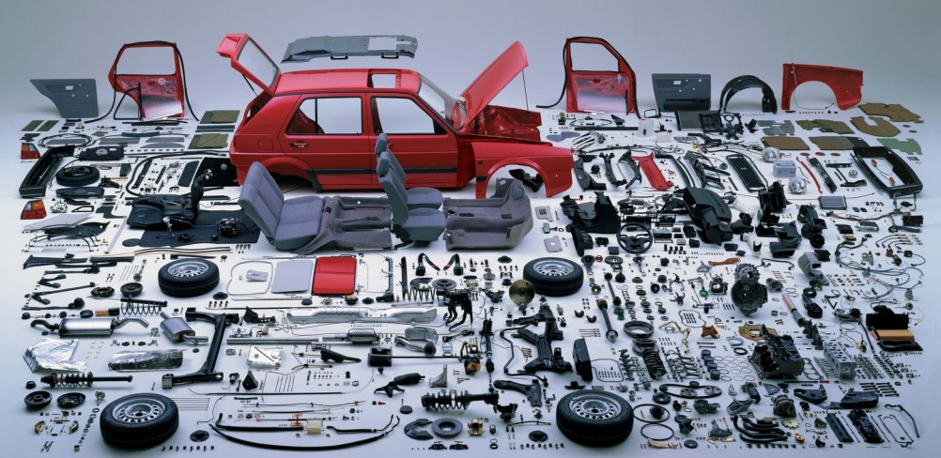
Step 1
Read the requirements section:
  What are the key terms?
  What are the key concepts?
  How is the response to be presented?

Slide 3
Step 1 - Responses
What are the key terms?
  Analyse; Interpret; Evaluate; Recommend
What are the key concepts?
  Controls over inventories
How is the response to be presented?
  Business report extract

Slide 4

Step 2
What does analyse mean?
What does interpret mean?
What does evaluate mean?
What does recommend mean?

Slide 5
Step 2 - Responses
What does analyse mean?
  To examine or consider something in order to explain and interpret it
What does interpret mean?
  To use knowledge and understanding to recognise trends and draw conclusions from given information
What does evaluate mean?
  To judge on the appropriateness; is it good, is it inappropriate
What does recommend mean?
  To express a good opinion of

Slide 6

Step 3 – Identify and list
Read the second paragraph – what is good/appropriate?
List them
Good
  Security cameras
  Insurance cover

Slide 7

Step 3 – Identify and list
Read the second paragraph – what is inappropriate?
List them
Inappropriate
  Unlocked warehouse
  No one responsible for receiving deliveries

Slide 8
Step 3 – Identify and list
Why are they inappropriate?
Unlocked warehouse – open to theft by public; void insurance cover
No one responsible for receiving deliveries – no check on quality, number of stock delivered; theft or damage in transit

Slide 9
Step 3 – Identify and list
Read the third paragraph – what is good/appropriate?
List them
Good
  Sufficient stock

Slide 10
Step 3 – Identify and list
Read the third paragraph – what is inappropriate?
List them
Inappropriate
  No knowledge of quantity of stock held
  Same suppliers – no checking of pricing

Slide 11
Step 3 – Identify and list
Why are they inappropriate?
No knowledge of stock held – overstocked; money tied up which could be used in other areas to generate profit
Same suppliers – could same quality of stock be purchased for less?

Slide 12
Step 4 – Organise information
Use mind map
5 Ws
Storage
Purchasing &
delivery
Control over
inventories
Security
Maintaining/monitoring
levels

Slide 13
Step 4 – Organise information
Group points under headings
Include recommendations to address inappropriate practices or to improve practices

Slide 14
Step 4 – Organise information
Storage - appropriate
  Warehouse
  Retail store with shelving

Slide 15
Step 4 – Organise information
Security controls
  Appropriate – security cameras; insurance cover
  Inappropriate – unlocked warehouse
  Recommendations –
    warehouse locked at all times

Slide 16
Step 4 – Organise information
Maintaining and monitoring levels of inventories
  Inappropriate – lack of knowledge of levels of stock
  Recommendations –
    Immediate implementation of perpetual inventory system; provides information on current stock levels; reorder point; reorder quantity

Slide 17
Step 4 – Organise information
Purchase and delivery of inventories
  Inappropriate – no one responsible for receiving stock; no checks on prices offered by other suppliers
  Recommendations –
    Appoint a person responsible for receiving, checking and unpacking of stock when delivered
    Periodic checks on prices offered by other suppliers

Slide 18
Step 5 - Outline
Complete your planning outline!

